Slide 1
Question-Answering
Natural Language Processing
(based on revision of Danqi Chen Lecture)

Slide 2
Announcement
TA announcements (if any)...

Slide 3
Suggested Readings
https://web.stanford.edu/~jurafsky/slp3/23.pdf (question answering)
SQuAD: 100,000+ Questions for Machine Comprehension of Text
Bidirectional Attention Flow for Machine Comprehension
Reading Wikipedia to Answer Open-Domain Questions
Latent Retrieval for Weakly Supervised Open Domain Question Answering
Dense Passage Retrieval for Open-Domain Question Answering
Learning Dense Representations of Phrases at Scale

Slide 4
Intro

Slide 5
Types of question answering
Reading comprehension
Given a passage (paragraph), a question (query), find the answer
A lot of work in 2016-2018
Open-domain question answering
Given a huge database, a question, find the answer
More practical than reading comprehension
Closed-book question answering
Given a question, find the answer
Very few work except T5…..so you can refer to the T5 paper…
Visual QA
Given an image, a question, find the answer
Merging human vision and understanding.
Not discussed today but as a pointer :-)

Slide 6
Reading Comprehension

Slide 7
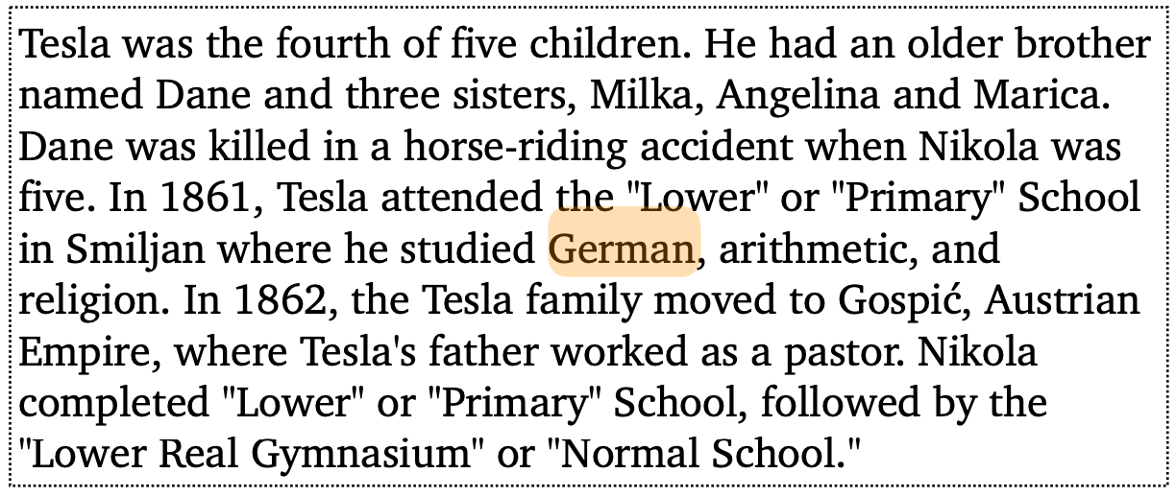
Reading comprehension
Reading comprehension: comprehend a passage of text and answer questions (P, Q) -> A
Q: What language did Tesla study while in school?
A: German

Slide 8
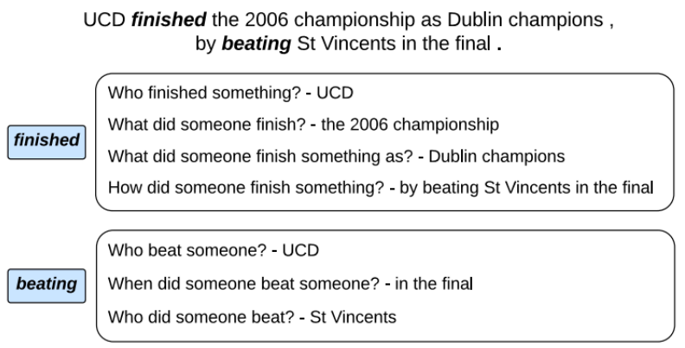
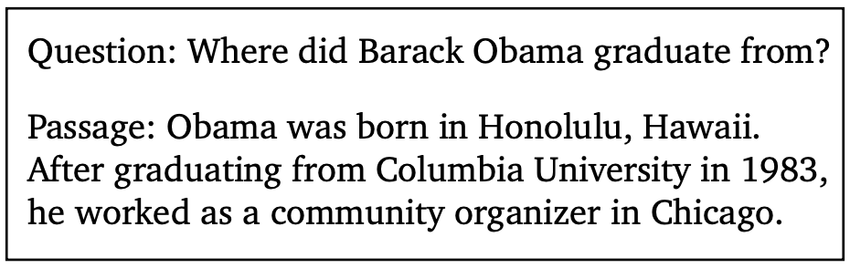
Why do we care about this problem?
Useful testbed for how well computer systems understand language
Many NLP tasks can be reduced to a reading comprehension problem:
Information extraction
Semantic role labeling
Levy et al., 2017
He et al., 2015

Slide 9
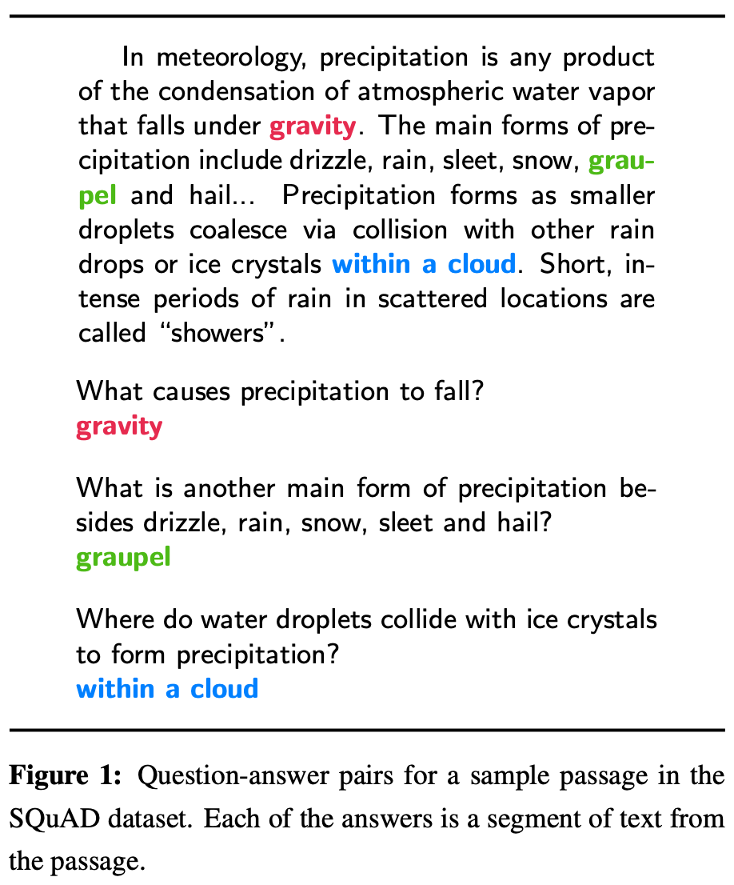
Stanford question answering dataset (SQuAD) [Rajpurkar et al., ACL 2016]
100k annotated (passage, question, answer) triples
Large-scale supervised datasets are also a key ingredient for training effective neural models for reading comprehension
Passages are selected from English Wikipedia, usually 100-150 words
Questions are crowd-sourced
Each answer is a short-segment of text (or span) in the passage
Analogical to “extractive” in summarization
Actually a big limitation of this dataset
SQuAD still remains the most popular reading comprehension dataset; it is “almost solved” today….exceeding human performance
SQuAD: 100,000+ Questions for Machine Comprehension of Text, Rajpurkar et al. 2016, https://aclanthology.org/D16-1264.pdf

Slide 10
Stanford question answering dataset (SQuAD)
Evaluation: exact match (EM) (0 or 1) and F1 (partial credit)
For development and testing sets, 3 gold answers are collected, because there could be multiple plausible answers
Compare the predicted answer to each gold answer (a, an, the, punctuations are removed) and take max scores. Finally, we take the average of all the examples for both EM and F1
Estimated human performance: EM = 82.3, F1 = 91.2
Q: What did Tesla do in December 1878?
A: {left Graz, left Graz, left Graz and severed all relations with this family}
Prediction: {left Graz and servered)
Exact match: max{0, 0, 0} = 0
F1: max{0.67, 0.67, 0.61} = 0.67

Slide 11
Stanford question answering dataset (SQuAD)
Problem formulation
Input: (N~100, M~15)
Output: (answer is a span in the passage)
How to build a model for SQuAD?
LSTM + attention (2016 - 2018)
Attentive Reader (Hermann et al., 2015), Stanford Attentive Reader (Chen et al., 2016), MatchLSTM (Wang et al., 2017), BiDFA (Seo et al., 2017), Dynamic coattention network (Xiong et al., 2017), DrQA (Chen et al., 2017), R-Net (Wang et al., 2017), ReasoNet (Shen et al., 2017)..
Fine-tuning BERT-like models for reading comprehension (2019+)

Slide 12
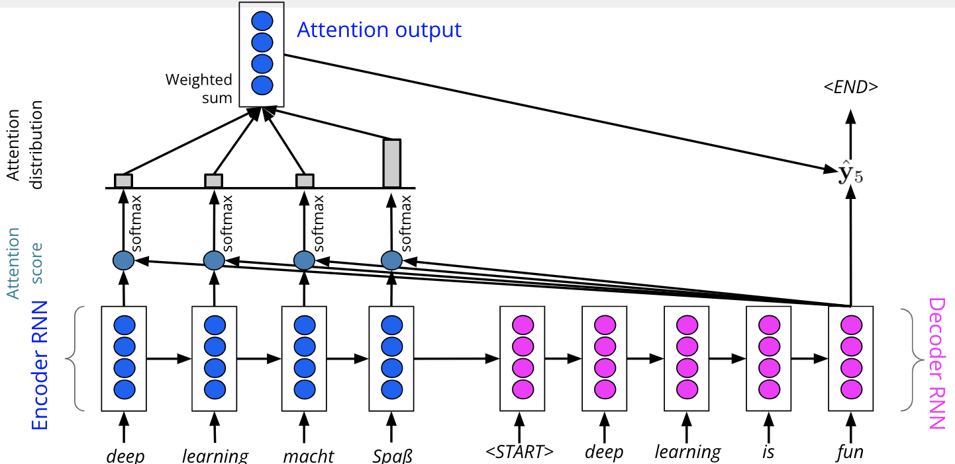
QA vs. MT on seq2seq with attention
Instead of source and target sentences, we also have two sequences: passage and question (lengths are quite imbalance)
We need to model which words in the passage are most relevant to the question (and which question words)
Attention is the key ingredient here, similar to which words in the source sentence are most relevant to the current target word…
We don’t need an autoregressive decoder to generate the target sentence word-by-word. Instead, we just need to train two classifiers to predict the start and end positions of the answer!

Slide 13
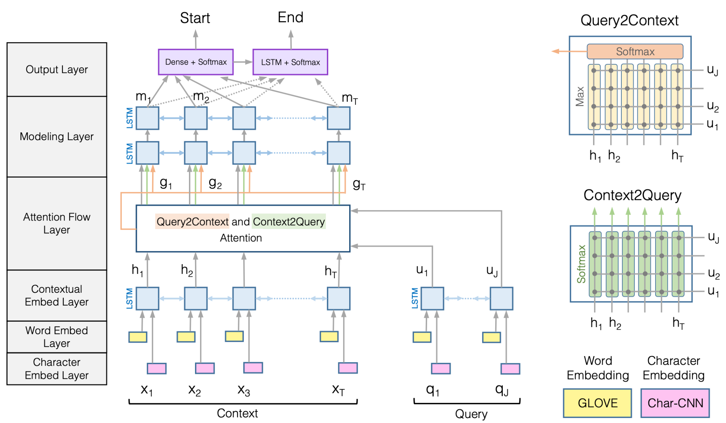
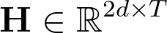

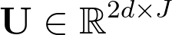

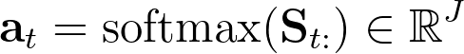
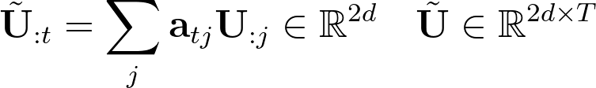
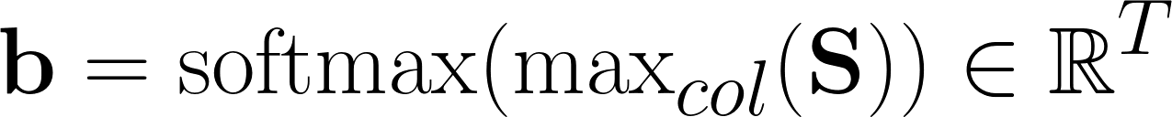
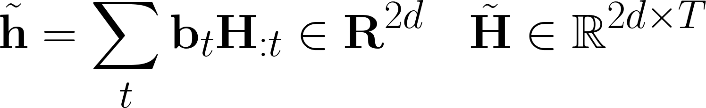
BiDAF: the Bidirectional Attention Flow model [Seo et al., ICLR 2017]
Character embedding layer: obtained using CNN and max-pooling
Word embedding layer: GloVE
Contextual embedding layer: biLSTM, where from the context word and from
Attention flow layer:
First compute the similarity score for every pair of (h_{i}, u_{j}):
Context to query attention
Query to context attention
Bidirectional Attention Flow for Machine Comprehension, Seo et al. 2017, https://arxiv.org/pdf/1611.01603.pdf

Slide 14
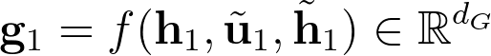
BiDAF: the Bidirectional Attention Flow model
Attention flow layer: concatenate vectors to get G, e.g., for the first t=1
Modeling layer: input G to the biLSTM layer for more massage…output M
Output layer: input M and G into two softmax classifier to predict the START and END position… (look at papers for the exact equation….for predicting END, they actually input M to yet another biLSTM…..)
Yay, done!

Slide 15
BiDAF: the Bidirectional Attention Flow model
Questions (query)
u₁ u₂ u₃ u_{J}
Where was Chaky born?
Chaky was born at Hong Kong.
h₁ h₂ h₃ h₄ h₅ h_{T}
Context (passage)
concatenate
concatenate
h₁ ∘ u₁
S₁₂
S₁₃
[h₁, u₁, h₁ ∘ u₁]
S₁₁
S₁₄
dot w/
w^{T}_{sim}
concatenate
elementwise mul
S₁₁

Slide 16
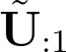

BiDAF: the Bidirectional Attention Flow model
Questions (query)
u₁ = U_{:1} u₂ u₃ u_{J}
Where was Chaky born?
Chaky was born at Hong Kong.
h₁ h₂ h₃ h₄ h₅ h_{T}
Context (passage)
Context to query attention
S_{1:}
5 | 1 | 15 | 5
softmax
Note: my softmax is just for demo purposes….
a₁
0.2 | 0.1 | 0.5 | 0.2
S₁₂
a₁₁
a₁₂
a₁₃
a₁₄
S₁₃
5
15
S₁₁
Note: these numbers are just for demo purposes….
1
5
dot w/
S₁₄
U
=
do this for all h

Slide 17

BiDAF: the Bidirectional Attention Flow model
Questions (query)
u₁ = U_{:1} u₂ u₃ u_{J}
Where was Chaky born?
Chaky was born at Hong Kong.
h₁ = H_{:1} h₂ h₃ h₄ h₅ h_{T}
Context (passage)
Query to context attention
where
is
Chaky
born
Chaky
S
5 | 1 | 15 | 5
1 | 5 | 1 | 1
10 | 1 | 10 | 15
1 | 1 | 1 | 5
20 | 1 | 5 | 10
20 | 1 | 5 | 10
15 | 5 | 15 | 5 | 20 | 20
is
maxcol
born
softmax
Note: these numbers are just for demo purposes….
at
b
Hong
0.03 | 0.01 | 0.05 | 0.01 | 0.45 | 0.45
Kong
dot w/
H
10
5
15
5
20
After dot
20
copy T times

Slide 18
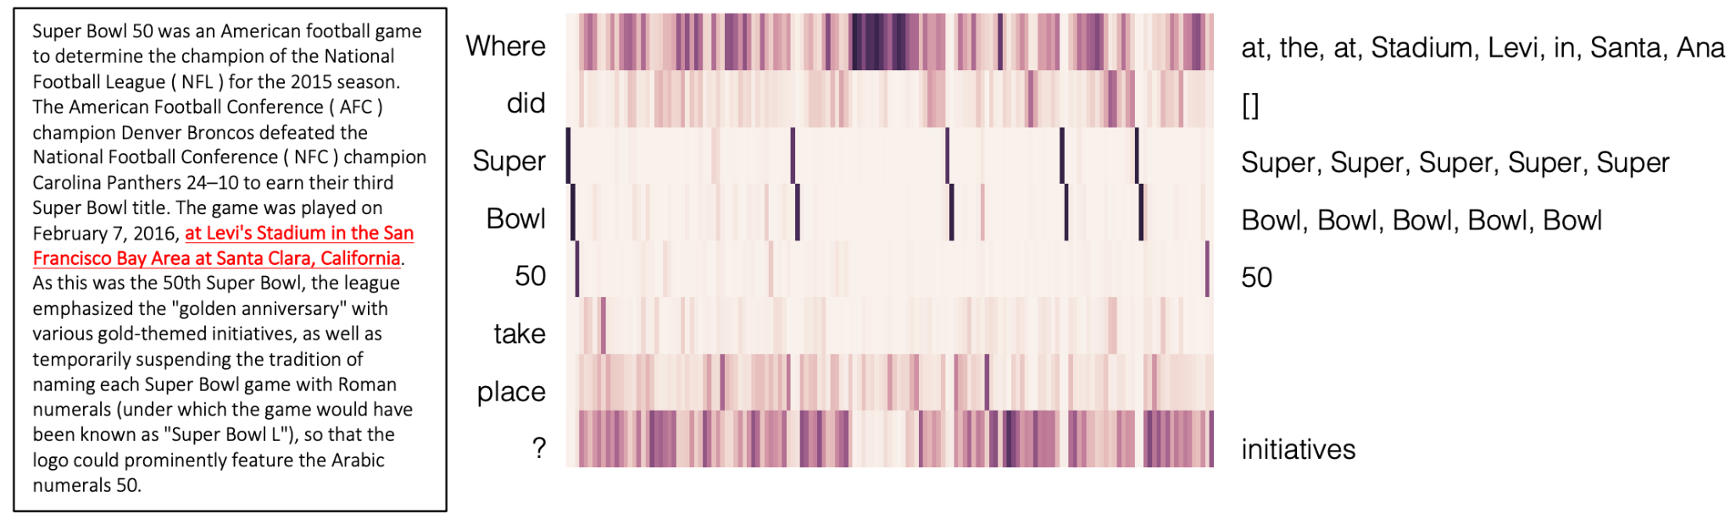
BiDAF: the Bidirectional Attention Flow model
This model achieved 77.3 F1 on SQuAD v1.1 (very good at that time)....
Performed some ablation experiments:
Without context-to-query attention -> 67.7 F1
Without query-to-context attention -> 73.7 F1
Without character embeddings -> 75.4 F1

Slide 19
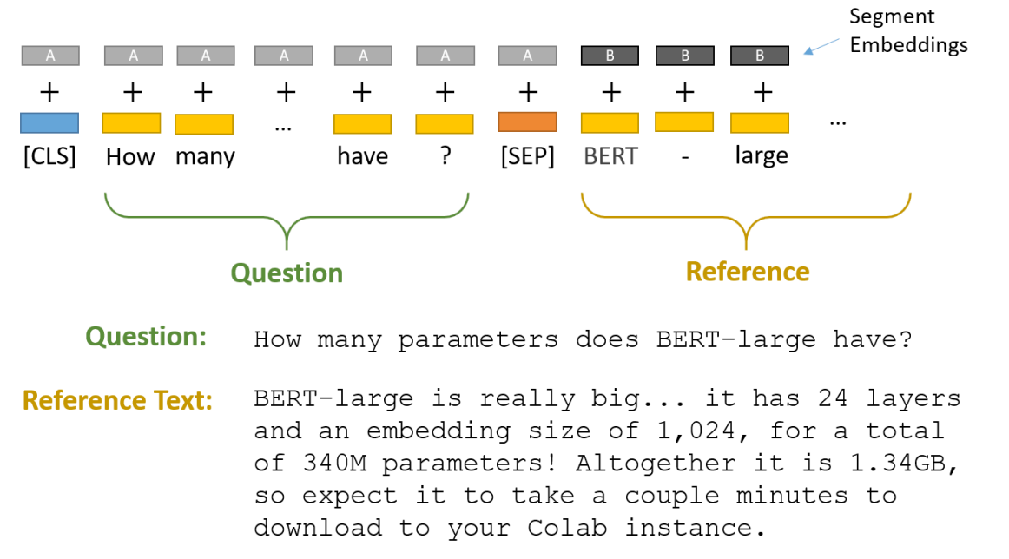
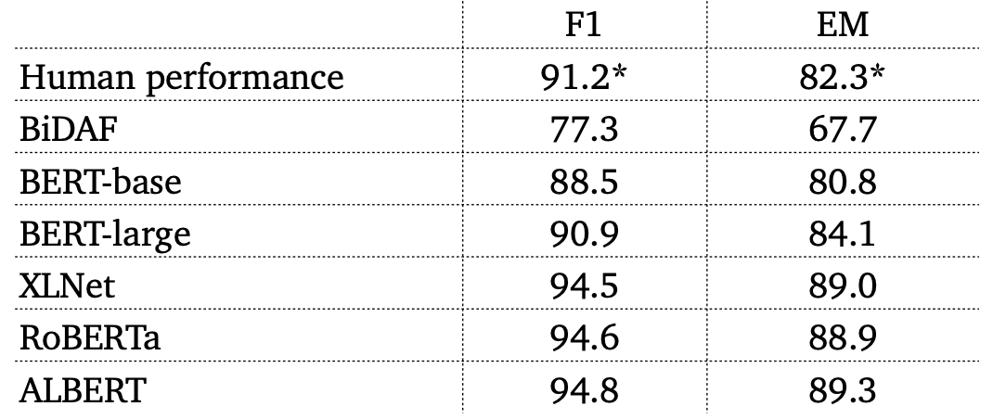
BERT for reading comprehension
Treat the query and passage as two segments
Pass the last layer hidden states (H) to predict the START and END
SpanBERT scores 94.6 on basic BERT!
Credit: https://mccormickml.com/2020/03/10/question-answering-with-a-fine-tuned-BERT/

Slide 20
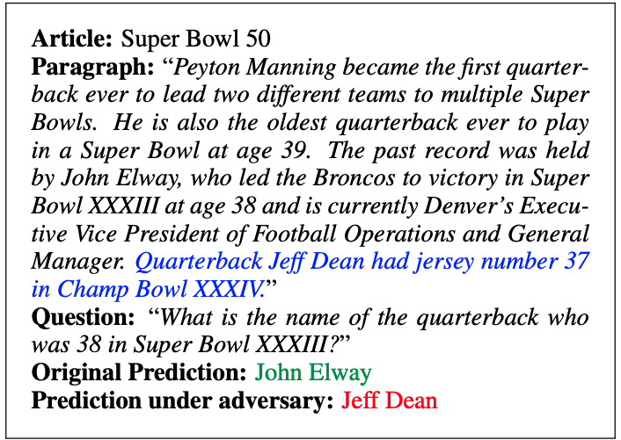
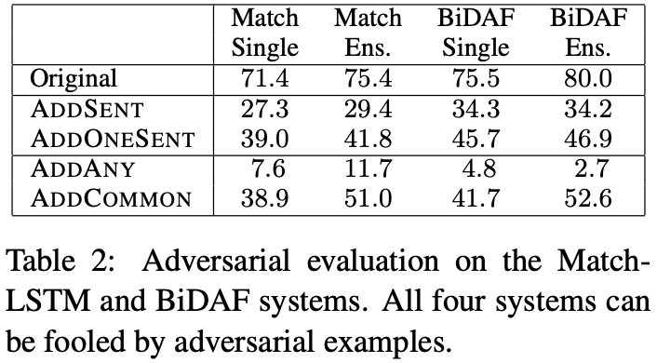
Is reading comprehension solved? [Jia et al., EMNLP 2017]
Current systems still perform poorly on adversarial examples….
Adversarial Examples for Evaluating Reading Comprehension Systems?, Jia et al., 2017, https://arxiv.org/pdf/1707.07328.pdf

Slide 21
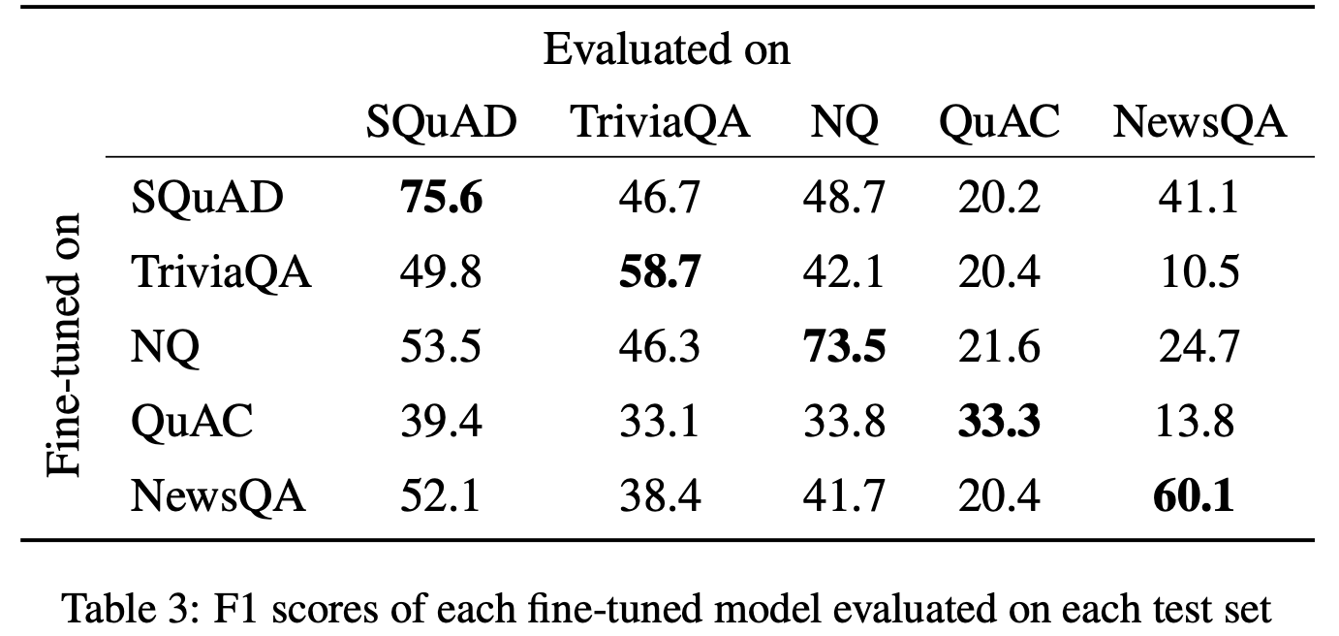
Is reading comprehension solved? [Sen et al., EMNLP 2020]
Can’t really generalize…..
What do models learn from question answering datasets?, Sen et al., 2020, https://arxiv.org/pdf/2004.03490.pdf

Slide 22
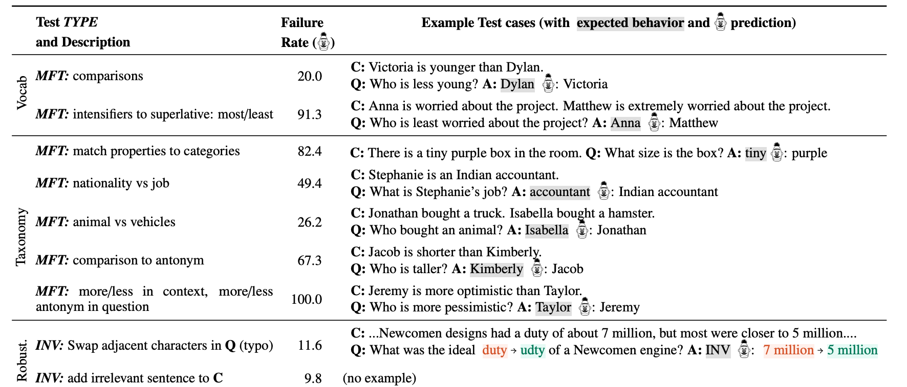
Is reading comprehension solved? [Ribeiro et al., ACL 2020]
Didn’t pass human-made test
Beyond Accuracy: Behavioral Testing of NLP Models with CheckList? (Best Paper Award), Ribeiro et al., 2020, https://arxiv.org/pdf/2005.04118.pdf

Slide 23
Open-domain (textual) question-answering

Slide 24
DrQA [Chen et al., ACL 2017]
We don’t have a given passage. Instead, we got a list of documents (e.g., Wikipedia). We don’t know where the answer is located.
Solution: Just learn a retriever, then once the candidate passages are retrieved, for each candidate passage, do BiDAF or BERT or whatever you like!
How to make the retriever: TF-IDF document retrieval works fine. TF-IDF is simply ranking the documents by prioritizing (1) lower the weights of highly frequent words, and (2) words matching the queries. More can be studied in https://web.stanford.edu/class/cs276/19handouts/lecture6-tfidf-1per.pdf
So many candidate passages? Don’t worry, just treat all of them as just one passage :-) and feed them to BiDAF or BERT or whatever reader…
Reading Wikipedia to Answer Open-Domain Questions, Chen et al., 2017, https://arxiv.org/pdf/1704.00051.pdf

Slide 25
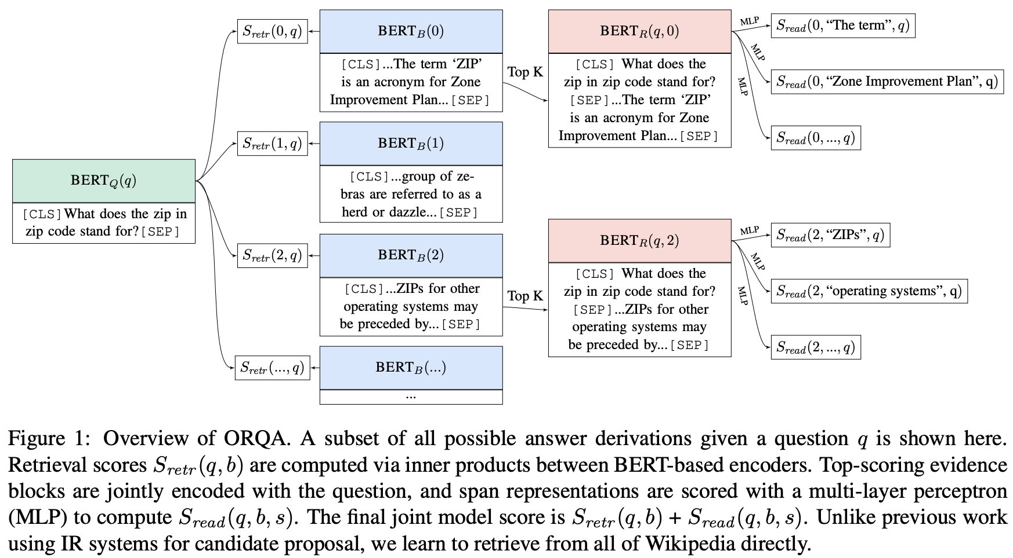
Training the retriever [Lee et al., ACL 2019]
Can also train a deep learning based retriever. Idea:
Each text passage is encoded as a vector using BERT
Each question is encoded as a vector using BERT
The retriever score is based on a dot product between these two vectors
Limitations: computationally expensive….
Latent Retrieval for Weakly Supervised Open Domain Question Answering, Lee et al., 2019, https://arxiv.org/pdf/1906.00300.pdf

Slide 26
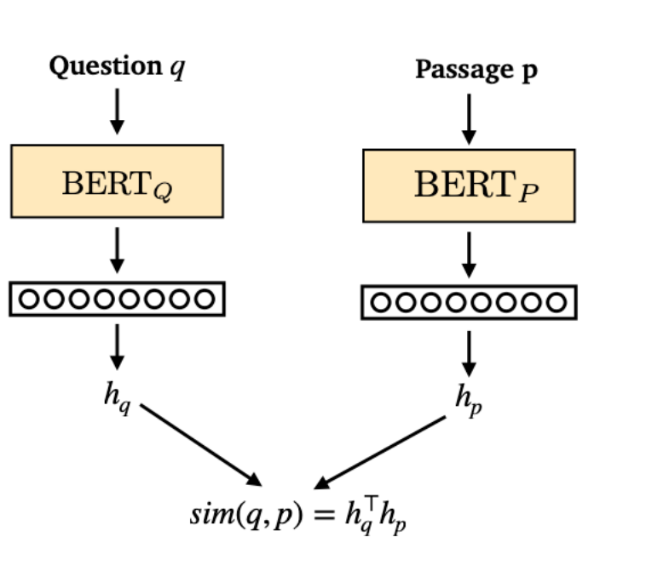
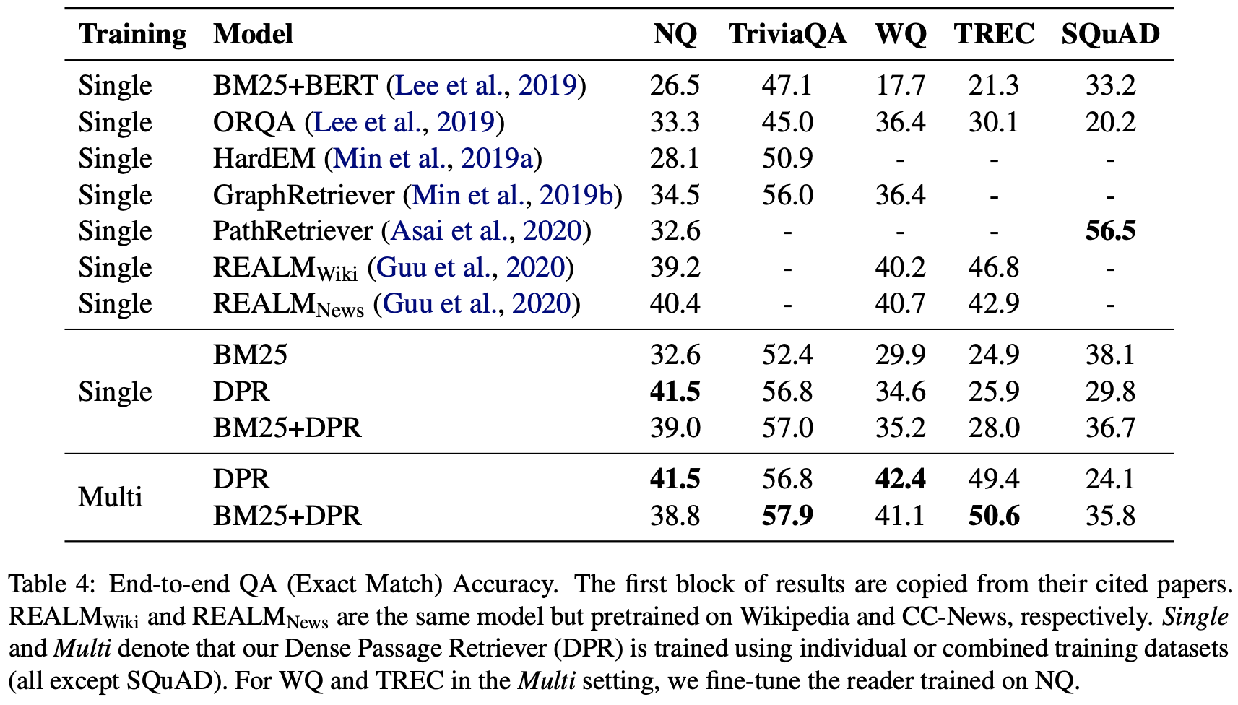
Just use the BERT! [Karpukhin et al., EMNLP 2020]
Just use the BERT without any additional pretraining…thus more efficient…
Dense Passage Retrieval for Open-Domain Question Answering, Karpukhin et al., 2020, https://arxiv.org/abs/2004.04906
Try demo at: http://qa.cs.washington.edu:2020/

Slide 27
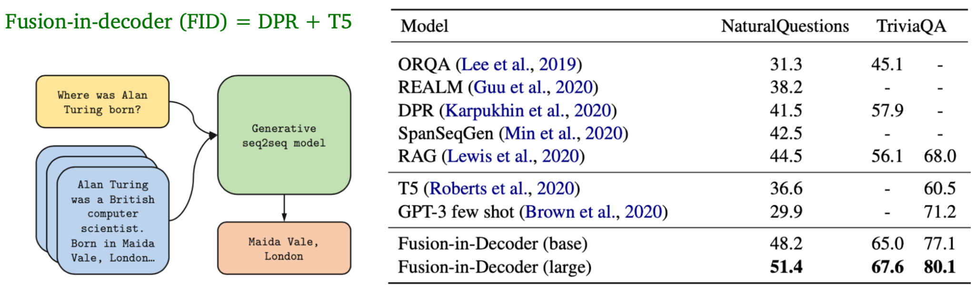
Generative-based [Izacard and Grave et al., ACL 2021]
Recent work shows that it is beneficial to generate answers instead of extracting answers
Leveraging passage retrieval with generative models for open domain question answering, Izacard and Grave, 2021, https://arxiv.org/abs/2004.04906

Slide 28
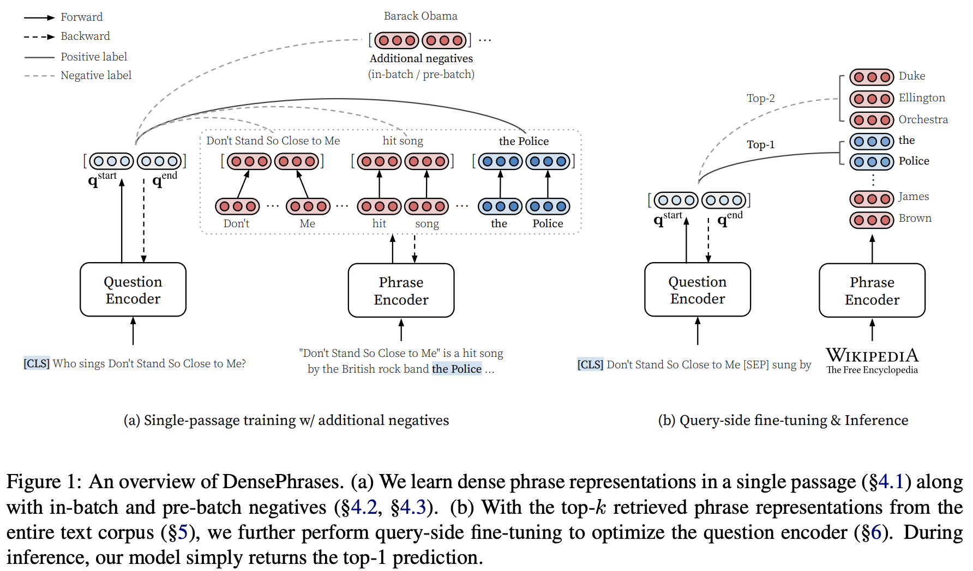
Encoding phrases [Lee et al., EMNLP 2020]
Encode all the phrases (60 billion phrases in Wikipedia) and only do nearest neighbor search without a BERT model
Real-Time Open-Domain Question Answering with Dense-Sparse Phrase Index, Seo et al. 2019, https://arxiv.org/pdf/1906.05807.pdf
Learning Dense Representations of Phrases at Scale, Lee et al., 2020, https://arxiv.org/pdf/2012.12624.pdf

Slide 29
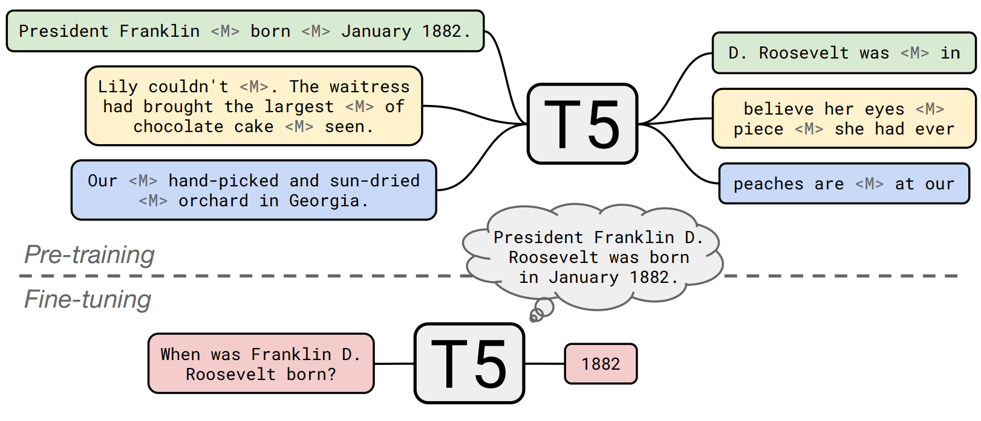
Don’t even need anything! [Roberts et al., EMNLP 2020]
Don’t even need the retriever or specialized reader (we called closed-book question answering..)
How Much Knowledge Can You Pack Into the Parameters of a Language Model?, Roberts et al. 2020, https://colinraffel.com/publications/emnlp2020how.pdf

Slide 30
Summary
Two types of problems we discussed
Reading comprehension - exceeded human performances…
BERT and BiDAF are two models we discussed….
Not really generalized or robust against adversarial attacks
Open-domain
Traditional retriever (e.g., TD-IDF) + neural reader
Joint BERT retriever + reader
Just use the BERT without any more pretraining
Accuracy remains low…
Using large pretrained models seems a good baseline now…
Many areas remain unsolved
Robust systems
Closed-book question-answering (answer without passages!)
Visual QA (https://paperswithcode.com/paper/vlmo-unified-vision-language-pre-training)
Still not sure why these recently proposed models work….
Better evaluation? - emphasize more on “knowing” rather than “memorizing”?

